Slide 1
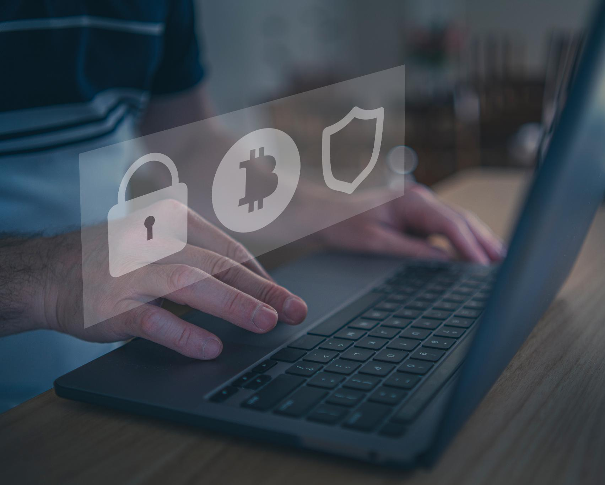
Cyber Safety: Cyber Bullying and Digital Footprints
Protecting yourself online and managing digital reputation
Notes:
AI-generated content may be incorrect. --- This presentation addresses important aspects of cyber safety tailored for 17 to 18-year-olds. We will explore the nature of cyberbullying, its consequences, how to respond effectively, and the significance of managing your digital footprint wisely. Image source: Microsoft 365 content library

Slide 2
News
https://www.bbc.com/news/articles/cx2gx28815wo - Weak password allowed hackers to sink a 158-year-old company -> “In KNP's case, it's thought the hackers managed to gain entry to the computer system by guessing an employee's password,”
https://www.theguardian.com/technology/2025/jul/23/sharepoint-targeted-by-chinese-threat-actor-hackers-says-microsoft - Microsoft Sharepoint had a vulnerability that was exploited leading to the breach of 400 organisations, focused on attacking Sharepoint severs via on-premises Sharepoint servers (Business websites that use Sharepoint)

Slide 3
Questions?
Summary of last week?
Any questions from last week?
Homework/assignment feedback?
Any questions in general?

Slide 4
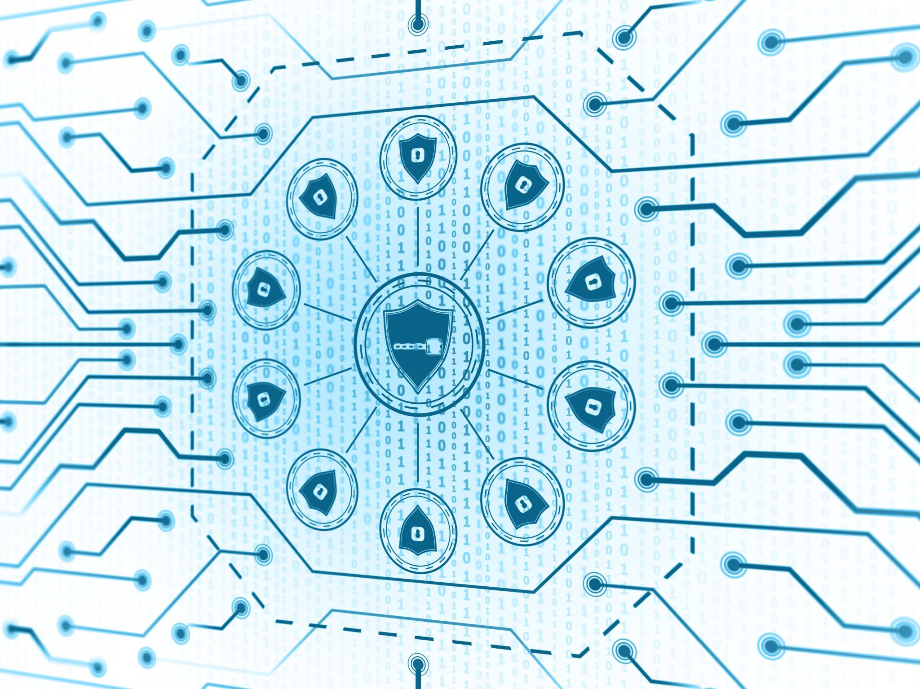
Agenda Overview: Cyber Safety Essentials
Recognising and Understanding Cyberbullying
Consequences of Cyberbullying: Lasting Effects and Outcomes
Responding to and Preventing Cyberbullying
Understanding Your Digital Footprint
Real-World Consequences and Staying Safe Online
Notes:
--- Today, we will cover recognising and understanding cyberbullying, its consequences, strategies for responding and prevention, understanding your digital footprint, and real-world implications of online behaviour. Image source: Microsoft 365 content library

Slide 5
WHAT?
Agenda Overview: Cyber Safety Essentials
Recognising and Understanding Cyberbullying
Consequences of Cyberbullying: Lasting Effects and Outcomes
Responding to and Preventing Cyberbullying
Understanding Your Digital Footprint
Real-World Consequences and Staying Safe Online
WHY?
HOW?
Notes:
--- Today, we will cover recognising and understanding cyberbullying, its consequences, strategies for responding and prevention, understanding your digital footprint, and real-world implications of online behaviour. Image source: Microsoft 365 content library

Slide 6
Recognising and Understanding Cyberbullying
Notes:
It is vital to identify what cyberbullying looks like and understand the motivations behind it to better protect yourself and others. This section explores common forms, emotional effects, and real-life cases.

Slide 7
What is Cyber Bullying?
Cyber: relating to or characteristic of the culture of computers, information technology, and virtual reality.
Bullying: seek to harm, intimidate, or coerce (someone perceived as vulnerable).
Cyber Bullying: Cyberbullying is the use of technology to harass, threaten, embarrass, or target another person
Notes:
Bullying is an ongoing and deliberate misuse of power in relationships through repeated verbal, physical, and/or social behaviour that intends to cause physical, social and/or psychological harm. It can involve an individual or group misusing their power, or perceived power, over one or more persons who feel unable to stop it from happening.

Slide 8
Example:
Posting comments or rumors about someone online that are mean, hurtful, or embarrassing.
Threatening to hurt someone or telling them to kill themselves.
Posting a mean or hurtful picture or video.
Pretending to be someone else online in order to solicit or post personal or false information about someone else.
Posting mean or hateful names, comments, or content about any race, religion, ethnicity, or other personal characteristics online.
Creating a mean or hurtful webpage about someone.
Doxing, an abbreviated form of the word documents, is a form of online harassment used to exact revenge and to threaten and destroy the privacy of individuals by making their personal information public, including addresses, social security, credit card and phone numbers, links to social media accounts, and other private data.
Notes:
Bullying is an ongoing and deliberate misuse of power in relationships through repeated verbal, physical, and/or social behaviour that intends to cause physical, social and/or psychological harm. It can involve an individual or group misusing their power, or perceived power, over one or more persons who feel unable to stop it from happening.

Slide 9
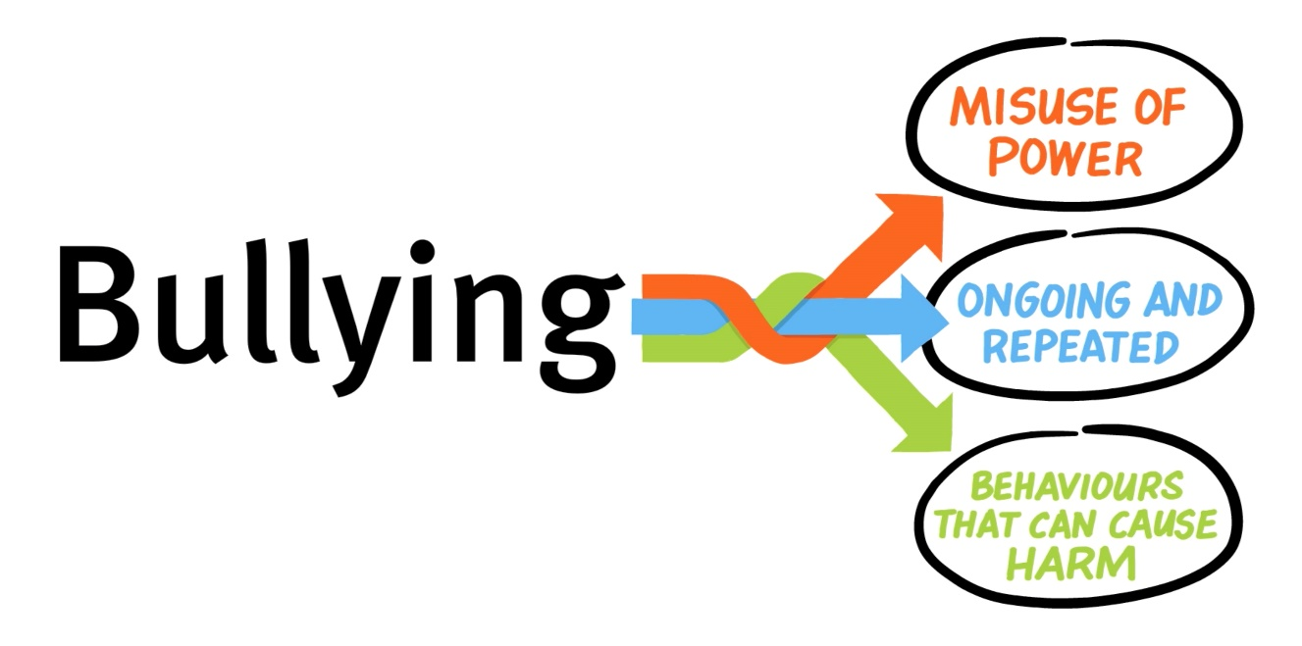
What is Cyber Bullying not?
Single incidents and conflict or fights between equals, whether in person or online, are not defined as bullying. – Bullying Go Away (Au.Gov)
A one-off comment, no matter how defamatory or hurtful, is not considered cyberbullying if it is not repeated or it was not intended to cause harm. – Tech Target
Notes:
Teacher notes:
A national definition provides us with a collective understanding of what bullying is, and also what bullying is not. It is important for students to recognise the differences.
This could be an opportunity to tie in conversations about respectful relationships with the class.
Highlight the following points with the class.
Bullying has three main features:
it involves a misuse of power in a relationship
it is ongoing and repeated, and
it involves behaviours that can cause harm.

Slide 10
Activity:
Cyber Bullying | Not Cyber Bullying
Notes:
In your groups come up with one or two controversial scenarios where it either is or is not based on the definitions we just learnt. Try to make them as ordre line as possible to help address or ask questions you may have in the future.

Slide 11






Where can Cyber Bullying happen?
Anywhere Online
Notes:
Bullying can happen in person or online, via various digital platforms and devices and it can be obvious (overt) or hidden (covert). Bullying behaviour is repeated, or has the potential to be repeated, over time (for example, through sharing of digital records).
Bullying of any form or for any reason can have immediate, medium and long-term effects on those involved, including bystanders
What do you think the difference is between obvious bullying and hidden bullying?

Slide 12

Common Forms of Cyberbullying (Social Media, Messaging Apps, Group Chats)
Social Media Harassment
Hurtful comments and negative interactions on social media platforms contribute significantly to cyberbullying.
Messaging Apps Abuse
Hostile or threatening messages exchanged privately through messaging apps often lead to cyberbullying incidents.
Group Chat Bullying
Cyberbullying also occurs within group chats where victims face exclusion or targeted negative remarks.
Notes:
--- Cyberbullying can take many shapes — from hurtful comments on social media to hostile messages in group chats. Recognising these forms helps in early detection and appropriate action. Image source: Microsoft 365 content library

Slide 13
Why can Cyber Bullying happen?
Attacker: An attacker may seek to harm, embarrass, annoy, rage bait, or bully someone for amusement, out of peer pressure, or for some other unmotivated reason, etc
Victim: Although not the fault of the victim, a victim can take steps to minimize what damage can be caused by a cyber bully
Notes:
Bullying can happen in person or online, via various digital platforms and devices and it can be obvious (overt) or hidden (covert). Bullying behaviour is repeated, or has the potential to be repeated, over time (for example, through sharing of digital records).
Bullying of any form or for any reason can have immediate, medium and long-term effects on those involved, including bystanders
What do you think the difference is between obvious bullying and hidden bullying?

Slide 14
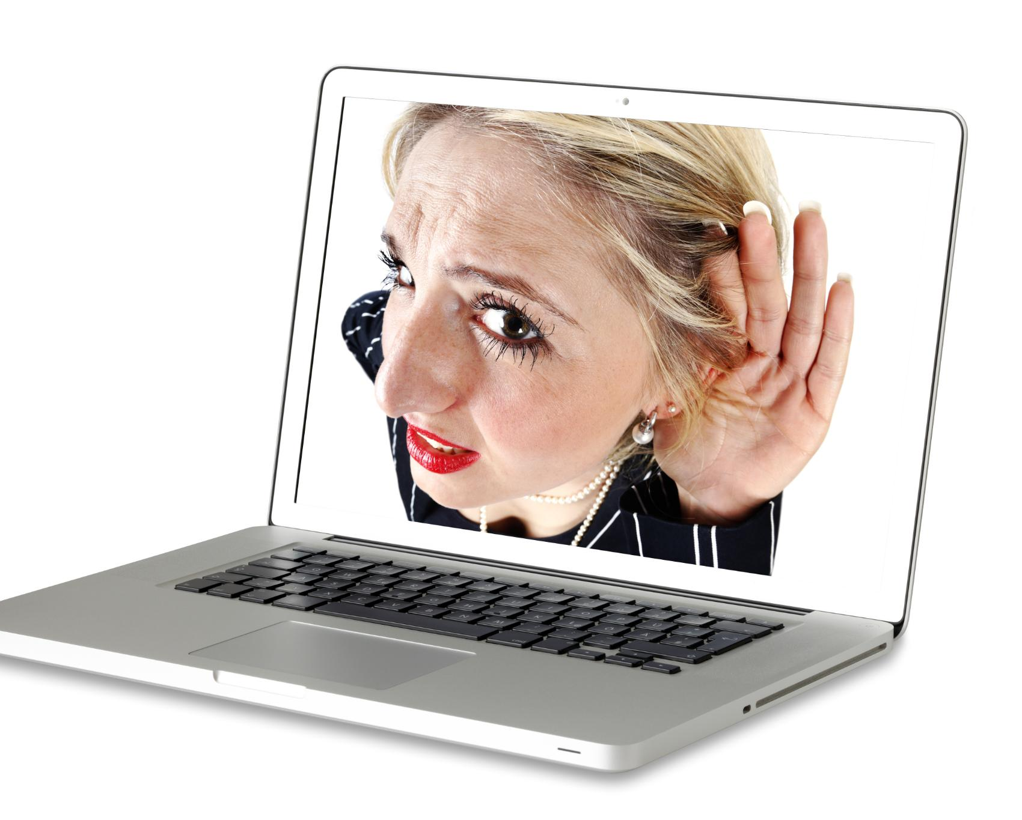
Motivations Behind Cyberbullying and Its Emotional Impact
Reasons for Cyberbullying
Individuals cyberbully often to seek power or retaliate against others, driven by complex motives.
Emotional Impact on Victims
Victims of cyberbullying frequently experience anxiety, depression, and social isolation.
Notes:
--- Understanding why individuals cyberbully, such as seeking power or retaliation, sheds light on its emotional toll on victims, including anxiety, depression, and isolation. Image source: Microsoft 365 content library

Slide 15
Activity:
Why would you be Cyber Bullied?
Think of a reason as to why someone would want to Cyber Bully you
Take note of what that person might use to do so
What will you do to ensure that person cant do that?
Things to consider
What private information of yours is accessible to public viewers?
What information do you have on your page are you comfortable with having on the internet forever?
What percentage of your messages are you comfortable with sharing with the public?
Notes:
What do you think the difference is between obvious bullying and hidden bullying?

Slide 16

Case Studies and Real-Life Examples of Cyberbullying
Understanding Cyberbullying Impact
Real-life cases highlight how cyberbullying deeply affects mental health and daily life of young people.
Varied Forms of Cyberbullying
Examples show cyberbullying can include harassment, exclusion, and spreading rumours on social platforms.
Importance of Awareness
Case studies emphasise the need for education to prevent and address cyberbullying effectively.
Notes:
--- Reviewing real scenarios helps illustrate the seriousness of cyberbullying and the variety of ways it can affect young people’s lives. Image source: Microsoft 365 content library

Slide 17
Consequences of Cyberbullying: Lasting Effects and Outcomes
Notes:
Cyberbullying has far-reaching consequences for both victims and perpetrators. This section highlights the enduring nature of online actions and their impact.

Slide 18

The Lasting Lifetime of Online Messages and Actions
Indefinite Accessibility
Online content often remains accessible forever, making digital footprints permanent and widespread.
Impact of Harmful Messages
Harmful online messages can continue to negatively affect individuals long after initial posting.
Constantly Present
Unlike bullying where it stops when you are away from the bully or at home, cyber bullying follows you everywhere, making it at times more dangerous than in person bullying.
Notes:
--- Online content can remain accessible indefinitely. This permanence means harmful messages can continue to affect individuals long after they are posted. Image source: Microsoft 365 content library

Slide 19

Potential Outcomes for Victims: Emotional, Social, and Academic Impact
Emotional Distress
Victims often experience significant emotional distress that affects their mental wellbeing and daily life.
Social Withdrawal
Social withdrawal is common, leading victims to isolate themselves from friends and social activities.
Academic Decline
Emotional and social challenges can cause a decline in victims' academic performance and engagement.
Anxiety
Cyber Bullying can lead to constant anxious feelings related to comments or attacks made from cyber bullies online.
Notes:
--- Victims may suffer from emotional distress, social withdrawal, and a decline in academic performance, emphasising the importance of timely support and intervention. Image source: Microsoft 365 content library

Slide 20
Consider:
The first or and old negative message, comment, or post you have received from someone online (doesn’t have to be bullying)
Can you still view that post/comment/message?
Is this person still in your life? (Do you see them?)
How does this comment/message affect you now?
Notes:
What do you think the difference is between obvious bullying and hidden bullying?

Slide 21
Potential Outcomes for Attackers: Legal, Educational, and Personal Consequences
Legal Actions
Cyberbullying perpetrators may be subject to criminal or civil legal consequences, including fines or prosecution.
Educational Disciplinary Measures
Schools can impose disciplinary actions such as suspension or expulsion on students involved in cyberbullying.
Personal Reputation Damage
Engaging in cyberbullying can harm personal relationships and social standing among peers and family.
Notes:
--- Perpetrators of cyberbullying can face legal actions, school disciplinary measures, and damage to their reputation and relationships. Image source: Microsoft 365 content library

Slide 22
Responding to and Preventing Cyberbullying
Notes:
Effective responses and prevention strategies empower young people to protect themselves and others from cyberbullying.

Slide 23
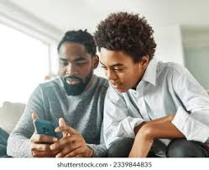
Practical Steps: Blocking, Reporting, and Seeking Help
Blocking Offenders
Blocking offenders helps prevent further harassment by stopping unwanted communication from bullies.
Reporting Incidents
Reporting cyberbullying to platform authorities enables swift action and enforcement of policies.
Seeking Support
Reaching out to trusted adults or support services provides emotional help and guidance.
Notes:
--- Blocking offenders, reporting incidents to platform authorities, and reaching out to trusted adults or support services are key steps in managing cyberbullying. Image source: Microsoft 365 content library

Slide 24

Practical Steps: Blocking, Reporting, and Seeking Help
Protect Personal Information
Keep personal details secure and enable privacy settings on social media to reduce potential risks and exposure to cyberbullying.
Warn friends
If it is from a mutual friend or account you can warn your friends or mutuals you trust to ensure they don’t go through the same thing.
Notes:
Image source: Microsoft 365 content library Encourage open communication with trusted adults to share online concerns. Safeguard personal information and use privacy settings on all social media platforms. If cyberbullying occurs, do not respond emotionally; instead, save evidence, block the bully, and report incidents to the platform or authorities for appropriate action.

Slide 25

How to Support Peers Who Are Being Targeted
Offer Empathy
Showing empathy helps victims feel understood and supported during difficult times.
Stand Against Bullying
Actively opposing bullying promotes a safer and more inclusive community.
Encourage Seeking Help
Motivating victims to seek help connects them to necessary resources and assistance.
Notes:
--- Offering empathy, standing against bullying, and encouraging victims to seek help can make a significant positive difference. Image source: Microsoft 365 content library

Slide 26

Activity:
Victim:
You are being cyber bullied by someone online, how do you address it?
Friend of a Victim:
A friend of yours has come to you saying they were a victim of cyber bullying, how do you help them?
Witness of a Victim:
You are scrolling on tikbook and see someone has commented harmful things on another’s post, you are not close with the victim but you can tell it is not a joke, what do you do?
Notes:
--- Practising responses through role-play prepares individuals to handle bullying situations calmly and safely. Image source: Microsoft 365 content library

Slide 27
Understanding Your Digital Footprint
Notes:
Your online actions create a digital footprint that can influence your future. Knowing how it works is key to maintaining control over your online presence.

Slide 28
What is your Digital Footprint?
A digital history of what you have posted or done while on a device
Cyber Security: Non – Repudiation -> The inability to deny that an action was carried out by someone as a history is kept.

Slide 29

How Online Posts, Pictures, and Comments Can Be Permanent
Permanence of Online Content
Content posted online can remain accessible even after deletion due to sharing and saving by others.
Importance of Caution
Thinking carefully before posting helps prevent unintended lasting consequences in digital spaces.
Notes:
--- Even deleted content may be saved or shared, making it important to think carefully before posting anything online. Image source: Microsoft 365 content library

Slide 30
Activity:
Go onto facebook/Instagram and find the oldest photo of a family member or friend you can find.
Type up a family member’s or friend’s name into the google search bar.

Slide 31
Who Can See Your Digital Footprint: Companies, Schools, and Strangers
Employers Access Footprint
Employers review digital footprints to assess candidates’ professionalism and suitability for job opportunities.
Schools Monitor Activity
Educational institutions may evaluate digital footprints for admissions and conduct decisions.
Strangers and Privacy Risks
Unknown individuals can access digital footprints, posing risks to personal privacy and security.
Notes:
--- Your digital footprint can be accessed by employers, educational institutions, and people you don’t know, affecting opportunities and your privacy. Image source: Microsoft 365 content library

Slide 32
Real-World Consequences and Staying Safe Online
Notes:
This section focuses on how past online behaviour can influence real-life outcomes and offers practical tips for managing online safety.

Slide 33

Examples of Old Posts Resurfacing and Their Impact on Opportunities
Impact on Job Prospects
Old online posts can influence employers' decisions, affecting candidates' job opportunities negatively or positively.
Effect on Personal Relationships
Resurfaced posts may affect trust and perceptions within personal relationships, highlighting risks of past online behaviour.
Need for Mindful Online Behaviour
Being cautious about what is shared online is crucial to protect future opportunities and personal reputation.
Notes:
--- Instances where old posts have affected job prospects or relationships demonstrate the importance of mindful online behaviour. Image source: Microsoft 365 content library

Slide 34
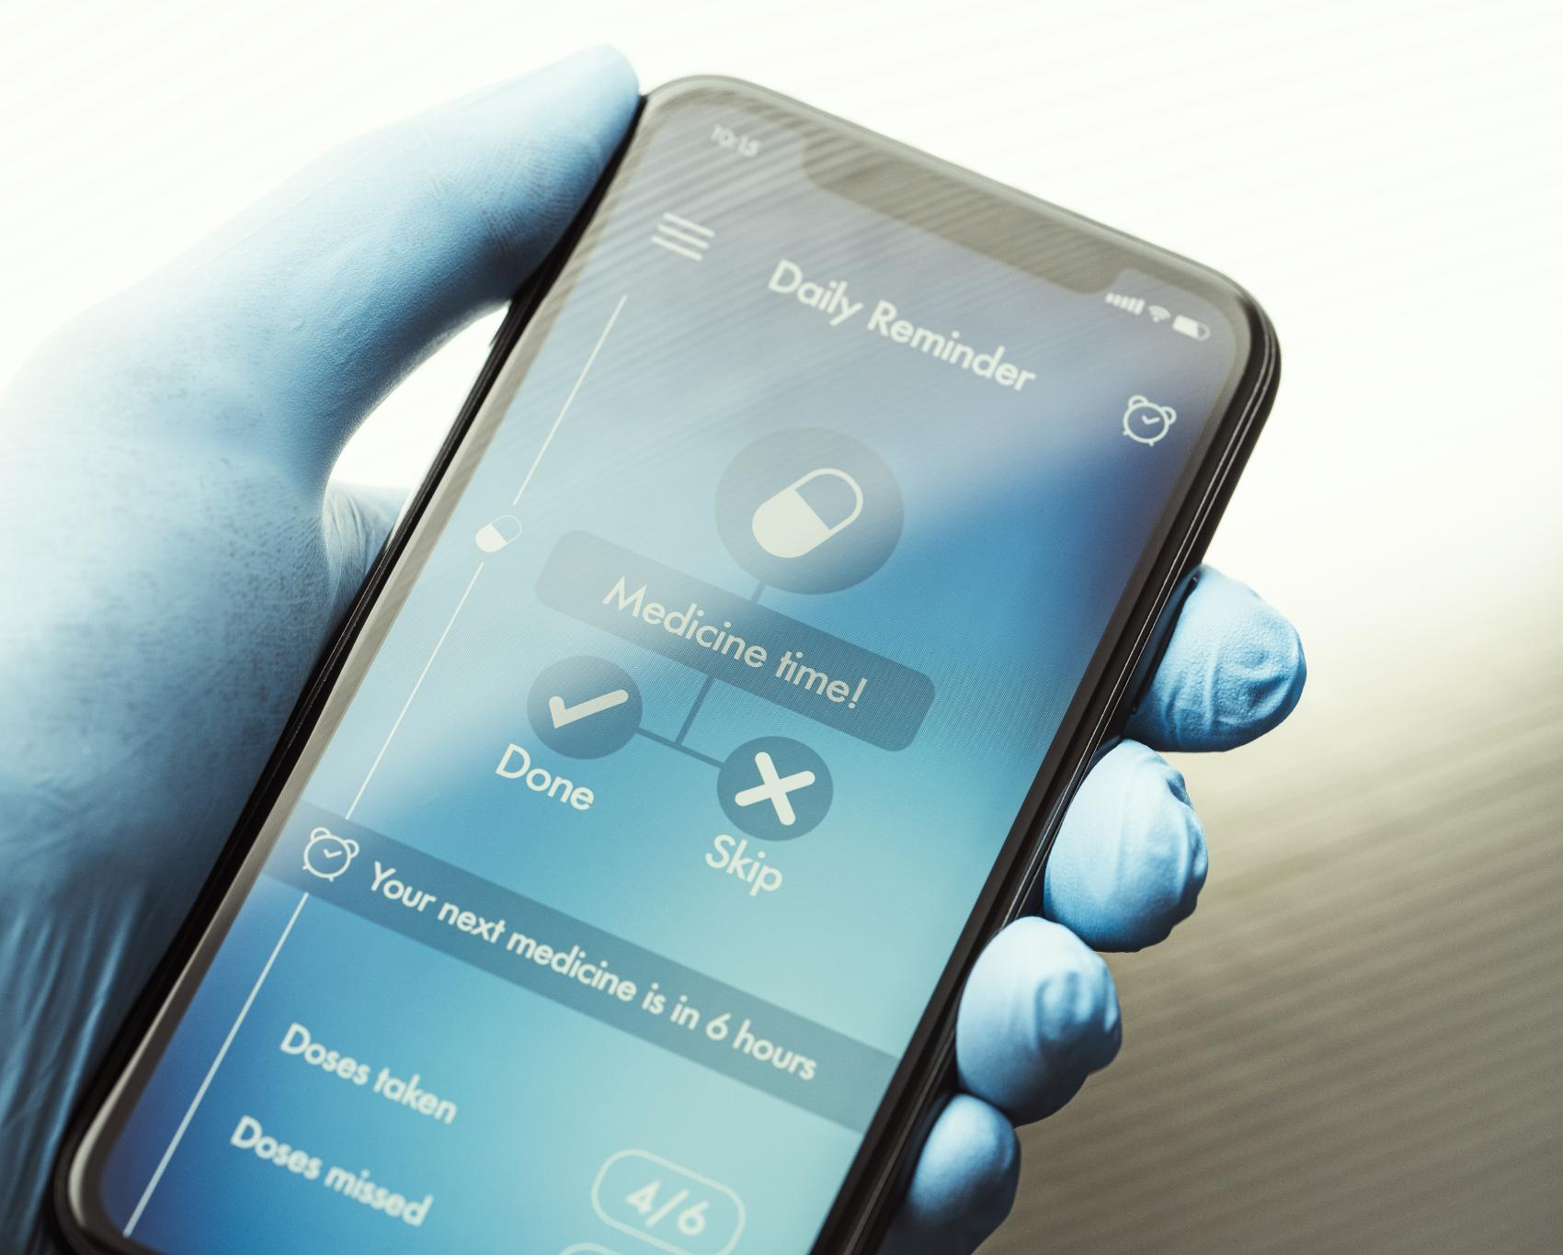
Tips for Managing Your Online Presence and Privacy Settings
Review Privacy Settings
Regularly check and update your privacy settings on social media platforms to control visibility.
Be Selective Sharing
Share personal information cautiously to protect your digital reputation and personal security.
Notes:
--- Regularly reviewing privacy settings and being selective about what you share helps protect your digital reputation. Image source: Microsoft 365 content library

Slide 35

Building a Positive Digital Reputation and Making Informed Choices
Thoughtful Online Presence
Being mindful about what you share online helps build a positive and respectful digital reputation.
Reflecting True Character
A positive digital reputation showcases your genuine values and influences opportunities positively.
Making Informed Choices
Careful decision-making online prevents misunderstandings and promotes constructive interactions.
Notes:
--- Creating a thoughtful and respectful online presence can open doors and reflect your true character positively. Image source: Microsoft 365 content library

Slide 36
Conclusion: Empowering Yourself for Safe and Responsible Online Living
Understanding Cyberbullying
Recognising cyberbullying helps you protect yourself and others from online harm and negativity.
Managing Your Digital Footprint
Being mindful about your digital footprint empowers you to shape your online reputation responsibly.
Building a Positive Digital Future
Supporting others online and promoting positivity creates a safer, more respectful digital community.
Notes:
By understanding cyberbullying and your digital footprint, you can take control of your online experience, support others, and build a positive digital future.

Slide 37
Assignments:
Assignment 1: Make sure that only people you trust can see your page (Private) and delete anything you don’t want to be on the internet
Assignment 2: Share a plan you have with someone about what you will do if you get cyber bullied or find out someone you know is being cyber bullied
Notes:
By understanding cyberbullying and your digital footprint, you can take control of your online experience, support others, and build a positive digital future.

Slide 38
Spare Time:
1 = https://www.commonsense.org/education/digital-passport
2 = https://www.pbs.org/wgbh/nova/labs/lab/cyber/
Interland
Go to the Interland website and play the Kind Level and the Responsible Sharing Level
Digital Passport
Go to 1 and play either the Share Jumper or E–Volve games
Nova Labs (Cyber Security)
Go to 2 play cyber security simulator
Notes:
By understanding cyberbullying and your digital footprint, you can take control of your online experience, support others, and build a positive digital future.

